Slide 1
Fraud Detection in Credit Card Transactions
Machine Learning Approach to Detect Fraudulent Transactions
SpringBoard
Shivangini
Marjiwe
March
2025

Slide 2

Introduction
SpringBoard
Credit card fraud is a major concern for financial institutions.
Fraudulent transactions cause significant financial losses.
Goal: Develop a machine learning model to detect fraud effectively.

Slide 3

SpringBoard
Objective: Identify fraudulent transactions while minimizing false positives.
Challenges:
1. Fraud transactions are rare (imbalanced dataset).
2. Need high precision & recall for fraud detection.
3. Performance Metrics: Precision, Recall, F1-Score, ROC AUC.

Slide 4

SpringBoard
Removed: Missing values, duplicates, and unnecessary features.
Dropped High-Cardinality Features: Street, city, zip, job, trans_num.
Converted Data Types: Optimized memory usage.

Slide 5
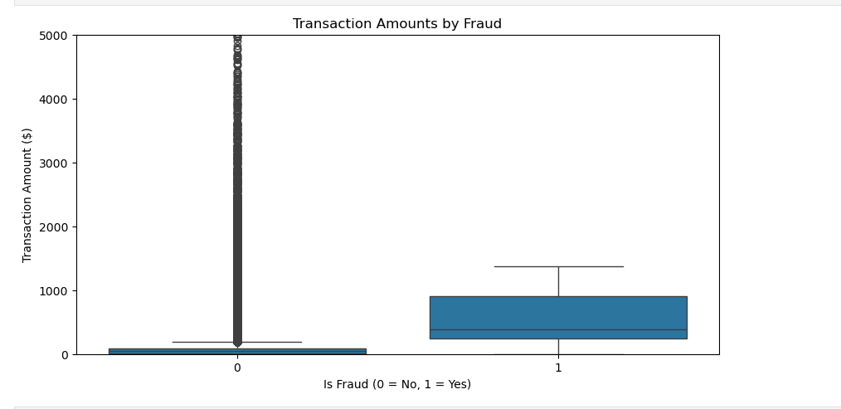
Exploratory Data Analysis (EDA)
SpringBoard
Fraud vs. Non-Fraud Transactions Distribution.
Transaction Amounts: Fraud transactions tend to have higher amounts.
Transaction Time Patterns: Fraudulent transactions peak at certain hours.
Merchant Category Analysis: Some categories have more fraud cases

Slide 6

Preprocessing
SpringBoard
One-Hot Encoding: Applied to categorical variables.
Feature Scaling: Standardized numerical features.
Train-Test Split: Stratified split to maintain class balance.
Sparse Format: Categorical features converted to save memory.

Slide 7
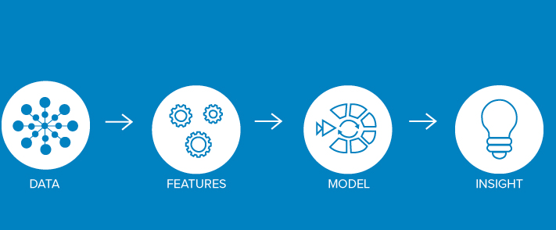
Feature Engineering
SpringBoard
Extracted Time-Based Features: Transaction hour, day of the week.
Encoded Merchant Categories: One-hot encoding.
Normalized Continuous Features: Transaction amount, latitude, longitude.
Final Features: Amt, city_pop, age, trans_hour, lat, long, merch_lat, merch_long.

Slide 8

Trained Models
SpringBoard
Model | ROC AUC | Recall | Precision | F1-Score
Balanced Random Forest | 0.9750 | 0.91 | 0.08 | 0.15
Decision Tree | 0.9421 | 0.94 | 0.09 | 0.16
Logistic Regression | 0.5403 | 0.00 | 0.00 | 0.00
Tuned Balanced RF | 0.9521 | 0.82 | 0.06 | 0.12

Slide 9
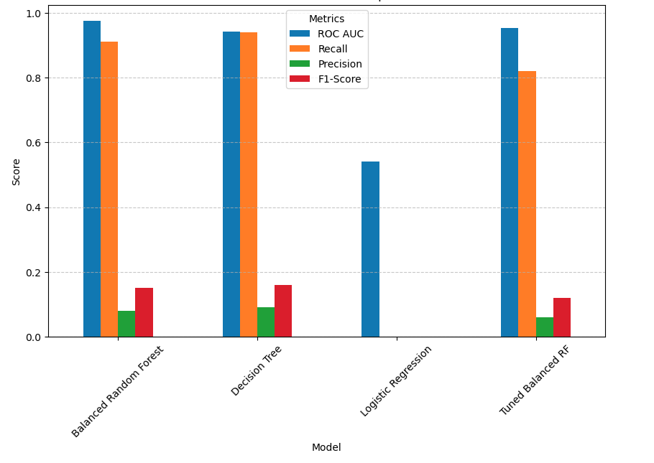
Model Performance Comparison
SpringBoard

Slide 10
V
SpringBoard
Model Selection
1
Best Model: Balanced Random Forest (BRF)
Why?
Highest ROC AUC (0.9750) and strong recall (0.91).
Best balance between fraud detection and false positives.
Why Not Tuned BRF?
Slightly worse recall than default BRF.
Why Not Logistic Regression?
Completely ineffective with 0 recall.
Balanced Random Forest
2
Decision Tree
3
Logistic Regression
4
Tuned Balanced RF

Slide 11
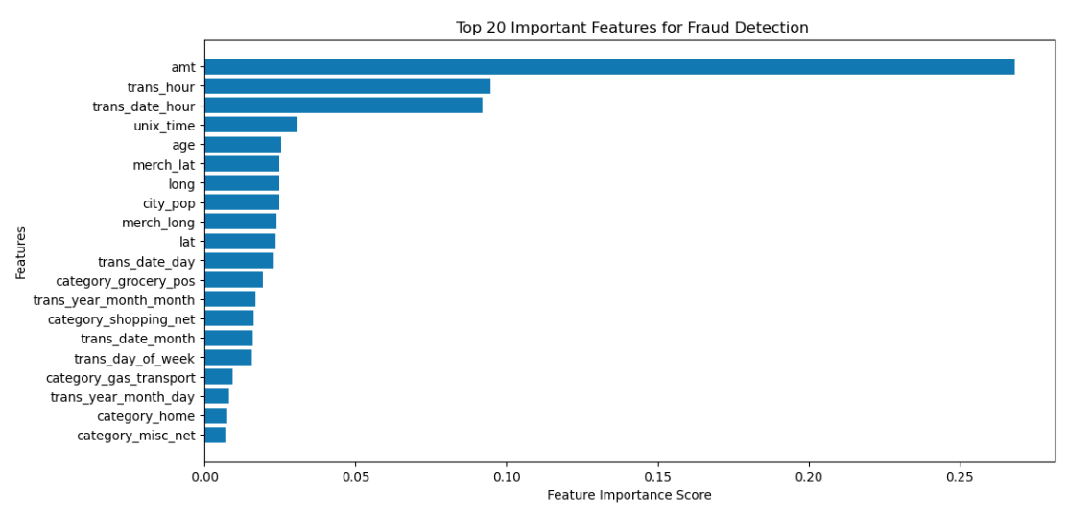
Feature Importance Analysis
SpringBoard
Top 5 Important Features for Fraud Detection (Balanced RF):
Transaction Amount (amt)
Transaction Hour (trans_hour)
Transaction Date Hour (trans_date_hour)
Unix Time (unix_time)
Age (age)
Location-based features (latitude/longitude) had lower importance.

Slide 12
Conclusion & Recommendations
SpringBoard
Findings:
Balanced Random Forest is the best model.
Fraud occurs more in high-amount transactions and specific time periods.
Recommendations:
Implement BRF Model in real-time fraud detection systems.
Enhance Fraud Prevention Measures during peak fraud hours.
Monitor High-Value Transactions closely.

Slide 13
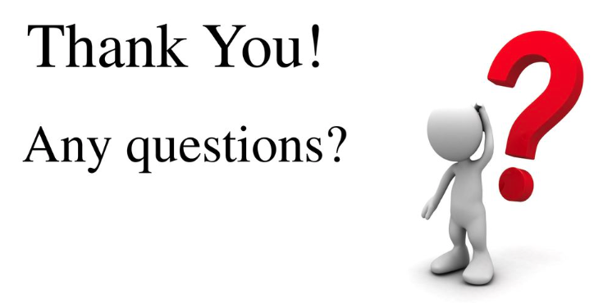
SpringBoard

